Slide 1
MLB salary Prediction
Phuc Ton Nguyen

Slide 2
Problem identification
San Francisco Giants wants to buy player and they are asking the evaluation of the players on the market to buy.

Slide 3
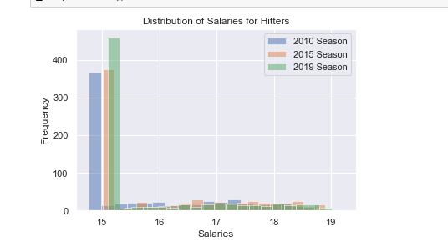
Hitter Recommendation and key findings

Slide 4
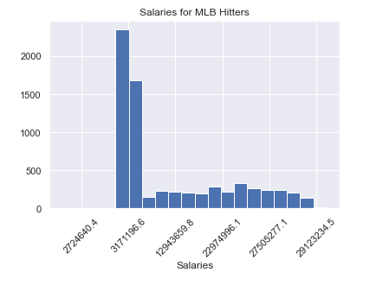
Hitter Recommendation and key findings

Slide 5
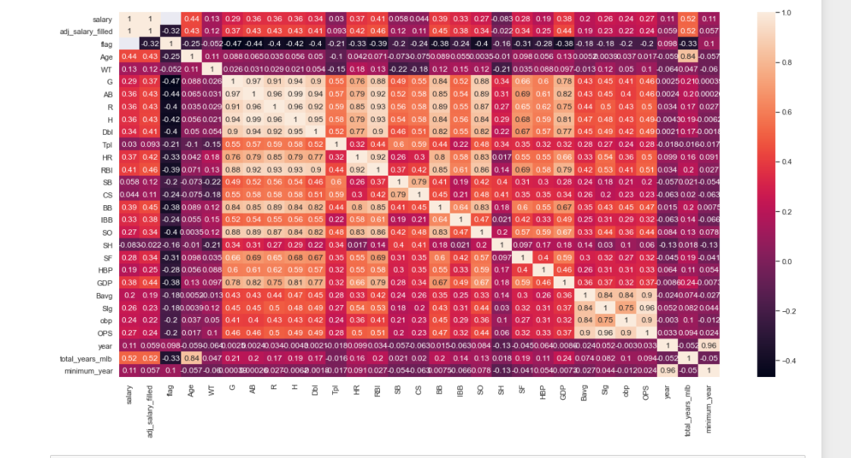
Hitter Recommendation and key findings

Slide 6
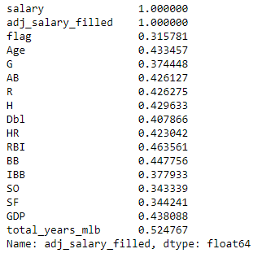
Hitter Recommendation and key findings

Slide 7
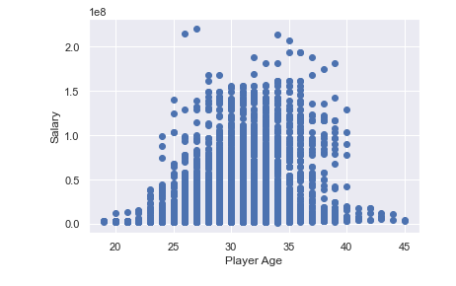
Hitter Recommendation and key findings

Slide 8
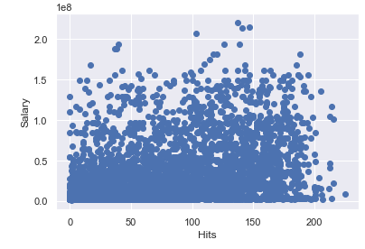
Hitter Recommendation and key findings

Slide 9
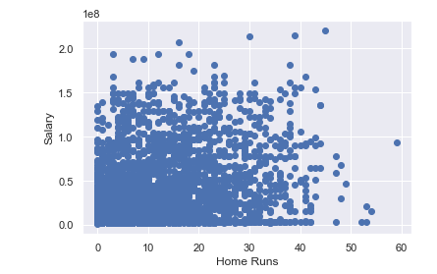
Hitter Recommendation and key findings

Slide 10
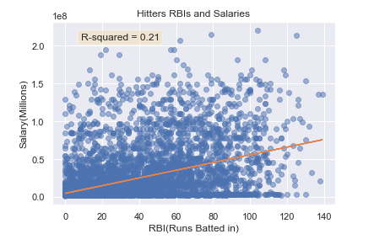
Hitter Recommendation and key findings

Slide 11
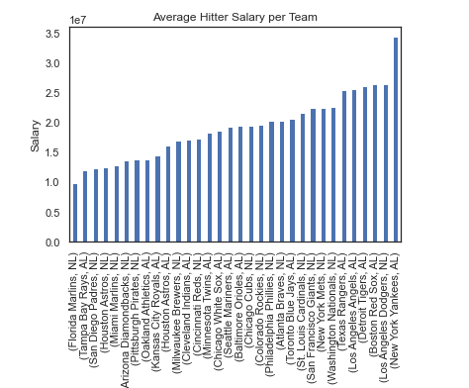
Hitter Recommendation and key findings

Slide 12
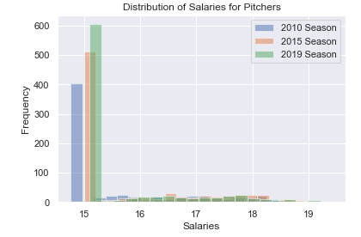
Pitcher Recommendation and key findings

Slide 13
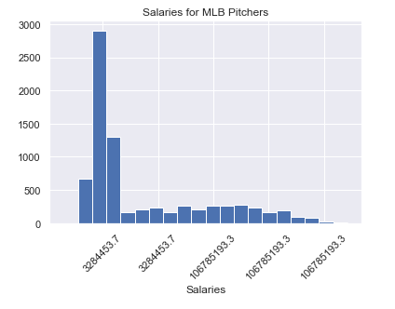
Pitcher Recommendation and key findings

Slide 14
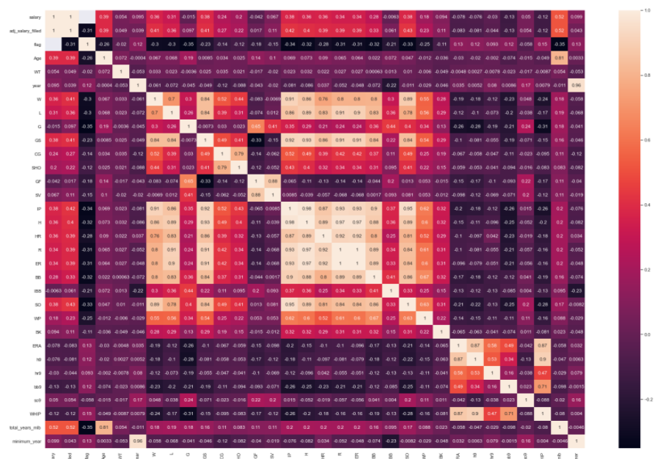
Pitcher Recommendation and key findings

Slide 15
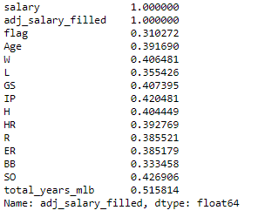
Pitcher Recommendation and key findings

Slide 16
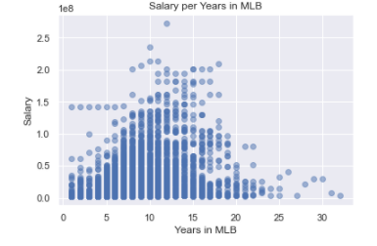
Pitcher Recommendation and key findings

Slide 17
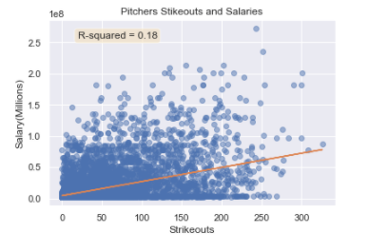
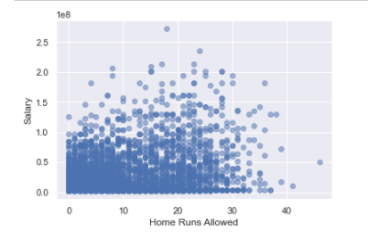
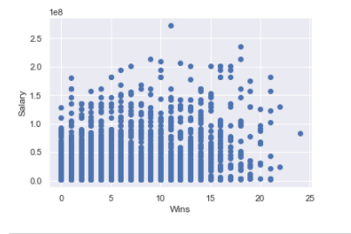
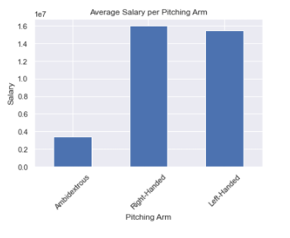
Pitcher Recommendation and key findings

Slide 18
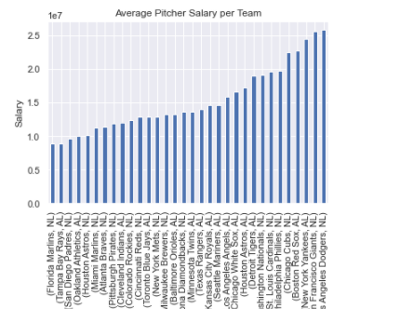
Pitcher Recommendation and key findings

Slide 19
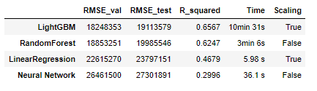
Modeling results and analysis

Slide 20
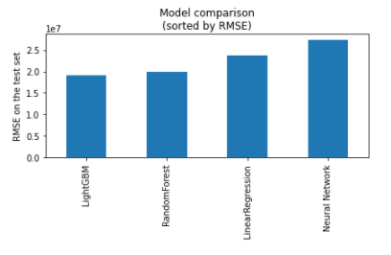
Modeling results and analysis

Slide 21
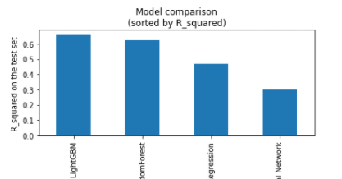
Modeling results and analysis

Slide 22
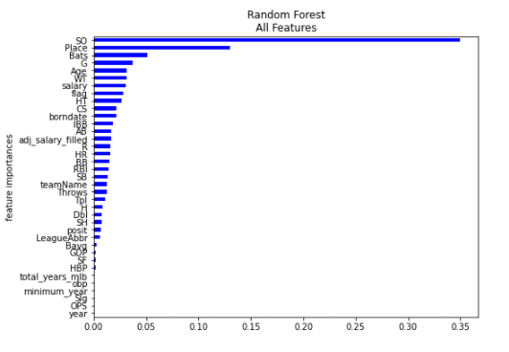
Modeling results and analysis
Important features:

Slide 23
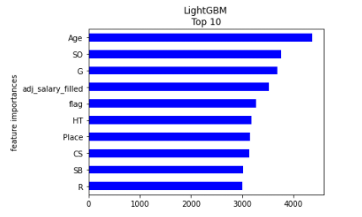
Modeling results and analysis
Important features:

Slide 24
Summary and conclusion
I have found the best MLB salary prediction models is the LightGBM models which showed high speed and best performance in RMSE. If one model should be selected I would recommend to use the LightGBM model since it is faster and it makes fewer outliers.

